Slide 1
FAULT-TOLERANCE
Fault-tolerance is the tendency to function in the presence of hardware or software failures.
In real-time systems, fault-tolerance includes design choices that transform hard real-time deadlines into soft ones.
Often encountered in interrupt-driven systems, which can provide for detecting and reacting to a missed deadline.
Fault-tolerance designed to increase reliability in embedded systems can be classified as either spatial or temporal. Spatial fault-tolerance
Methods involving redundant hardware or software
Temporal fault-tolerance
Techniques that allow for tolerating missed deadlines.
Temporal fault-tolerance is the more difficult to achieve because it requires careful algorithm design.

Slide 2
1 Spatial Fault-Tolerance
The reliability of most hardware can be increased using some form of spatial fault-tolerance using redundant hardware.
Two or more pairs of redundant hardware devices provide inputs to the system.
Each device compares its output to its companion.
If the results are unequal, the pair declares itself in error and the outputs are ignored.
An alternative is to use a third device to determine which of the other two is correct.
The penalty is increased cost, space, and power requirements.

Slide 3
1 Spatial Fault-Tolerance
Voting schemes can also be used in software to increase algorithm robustness.
Often like inputs are processed from more than one source and reduced to some sort of best estimate of the actual value.
For example, an aircraft’s position can be determined via information from satellite positioning systems, inertial navigation data, and ground information.
A composite of these readings is made using either simple averaging or a Kalman filter.

Slide 4
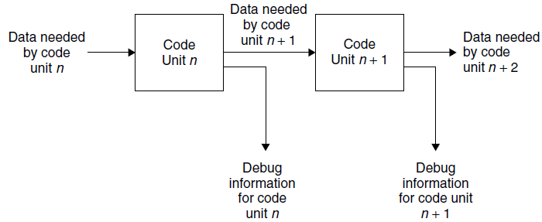
1.1 Checkpoints
A way to increase fault-tolerance in which intermediate results are written to memory at fixed locations in code for diagnostic purposes.
These locations, called checkpoints, can be used during system operation and during system verification.
If the checkpoints are used only during testing, then this code is known as a test probe.
Test probes can introduce subtle timing errors

Slide 5
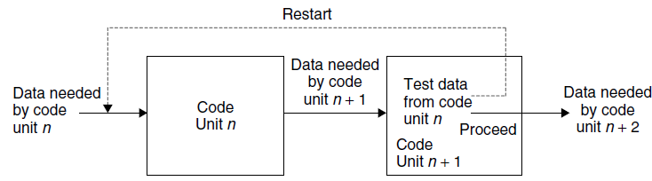
1.2 Recovery-Block Approach
Fault-tolerance can be further increased by using checkpoints in conjunction with predetermined reset points in software.
These reset points mark recovery blocks in the software.
At the end of each recovery block, the checkpoints are tested for “reasonableness.”
If the results are not reasonable, then processing resumes with a prior recovery block

Slide 6
1.2 Recovery-Block Approach
The point, of course, is that some hardware device (or another process that is independent of the one in question) has provided faulty inputs to the block.
By repeating the processing in the block, with presumably valid data, the error will not be repeated.
In the process-block model, each recovery block represents a redundant parallel process to the block being tested.
Although this strategy increases system reliability, it can have a severe impact on performance because of the overhead added by the checkpoint and repetition of the processing in a block.

Slide 7
2 Software Black Boxes
The software black box is related to checkpoints and is used in certain mission critical systems to recover data to prevent future disasters.
The objective of a software black box is to recreate the sequence of events that led to the software failure for the purpose of identifying the faulty code.
The software black-box recorder is essentially a checkpoint that records and stores behavioral data during program execution, while attempting to minimize any impact on that execution.
The execution of program functionalities results in a sequence of module transitions such that the system can be described as modules and their interaction.
When software is running, it passes control from one module to the next. Exchanging control from one module to the next is considered a transition.

Slide 8
2 Software Black Boxes
Call graphs can be developed from these transitions graphically using an N × N matrix, where N represents the number of
modules in a system.
When each module is called, each transition is recorded in a matrix, incrementing that element in a transition frequency matrix.
From this, a posteriori probability of transition matrix can be derived that records the likeliness that a transition will occur. The transition frequency and transition matrices indicate the number of observed transitions and the probability that some sequence is missing in these data.
Recovery begins after the system has failed and the software black box has been recovered.
The software black-box decoder generates possible functional scenarios based on the execution frequencies found in the transition matrix.
The generation process attempts to map the modules in the execution sequence to functionalities, which allows for the isolation of the likely cause of failure.

Slide 9
3 N-Version Programming
In any system, a state can be entered where the system is rendered ineffective or locks up due to some untested flow-of-control in the software for which there is no escape. Violation of event determinism
In order to reduce the likelihood of this sort of catastrophic error, redundant processors are added to the system.
These processors are coded to the same specifications, but by different programming teams.
It is therefore highly unlikely that more than one of the systems can lock up under the same circumstances.
Since each of the systems usually resets a watchdog timer, it quickly becomes obvious when one of them is locked up, because it fails to reset its timer.
The other processors in the system can then ignore this processor, and the overall system continues to function.
This technique is called N-version programming, and it has been used successfully in a number of projects, including the space shuttle general-purpose computer (GPC).

Slide 10
3 N-Version Programming
The redundant processors can use a voting scheme to decide on outputs, or, more likely, there are two processors, master and slave.
The master processor is on-line and produces the actual outputs to the system under control
The slave processor shadows the master off-line.
If the slave detects that the master has become hung up, then the slave goes on-line.

Slide 11
4 Built-In-Test Software
Built-in-test software (BITS) can enhance fault-tolerance by providing ongoing diagnostics of the underlying hardware for processing by the software. BITS is especially important in embedded systems.
For example, if an I/O channel is functioning incorrectly as determined by its onboard circuitry, the software may be able to shut off the channel and redirect the I/O.
Although BITS is an important part of embedded systems, it adds significantly to the worst-case time-loading
analysis.
This must be considered when selecting BITS and when interpreting the CPU utilization contributions that result from the additional software.

Slide 12
SYSTEMS INTEGRATION
Integration is the process of combining partial functionality to form the overall system functionality.
Because real-time systems are usually embedded, the integration process involves both multiple software units and hardware each of these parts developed by different teams or individuals within the project organization.
Although it is presumed that they have been rigorously tested and verified separately, the overall behavior of the system, and conformance to most of the software requirements, cannot be tested until the system is wholly integrated. Software integration can be further complicated when both hardware and software are new.

Slide 13
1 Goals of System Integration
The software integration activity has the most uncertain schedule and is typically the cause of project cost overruns. Moreover, the stage has been set for failure or success at this phase, by the specification, design, implementation, and testing practices used throughout the software project life cycle.
Hence, by the time of software integration, it may be very difficult to fix problems.
Indeed, many modern programming practices were devised to ensure arrival at this stage with the fewest errors in the source code.
For example, light-weight methodologies, such as extreme programming, tend to reduce these kinds of problems.

Slide 14
2 System Unification
Fitting the pieces of the system together from its individual components is a tricky business, especially for real-time systems.
Problems Encountered During System Integration:
Parameter mismatching
variable name mistyping
calling sequence errors
The system unification process consists of linking together the tested software modules drawn in an orderly fashion from the source-code library.
During the linking process, errors are likely to occur that relate to unresolved external symbols, memory assignment violations, page link errors
Once resolved, the loadable code or load module, can be downloaded from the development environment to the target machine.
This is achieved in a variety of ways, depending on the system architecture.
In any case, once the load module has been created and loaded into the target machine, testing of timing and hardware/software interaction can begin.

Slide 15
3 System Verification
Final system testing of embedded systems can be a tedious process, often requiring days or weeks.
During system validation a careful test log must be kept indicating the test case number, results, and disposition.
If a system test fails, it is imperative, once the problem has been identified and presumably corrected, that all affected tests be rerun.
These include
1. All module-level test cases for any module that has been changed.
2. All system-level test cases.
Even though the module-level test cases and previous system-level test cases have been passed, it is imperative that these be rerun to ensure that no side effects have been introduced during error repair.

Slide 16
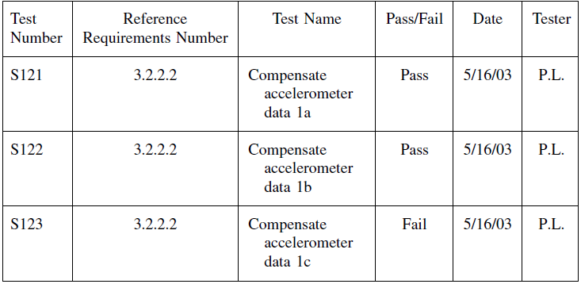
3 System Verification

Slide 17
4 System Integration Tools
It is not always easy to identify sources of error during a system test.
A number of hardware and software tools are available to assist in the validation of embedded systems.
Test tools make the difference between success and failure – especially in deeply embedded systems.
4.1 Multimeter
The use of a multimeter in the debugging of real-time systems may seem odd nowadays, but it is an important tool in embedded systems where the software controls or reads analog values through hardware.
The multimeter measures voltage, current, or power, and can be used to validate the analog input to or output from the system.

Slide 18
4 System Integration Tools
4.2 Oscilloscope
An oscilloscope, like a multimeter, is not always regarded as a software-debugging tool, but it is useful in embedded software environments.
Oscilloscopes range from the basic single-trace variety to storage oscilloscopes with multiple traces.
Oscilloscopes can be used for validating interrupt integrity, discrete signal issuance, and receipt, and for monitoring clocks.
The more sophisticated storage oscilloscopes with multiple inputs can often be used in lieu of logic analyzers, by using the inputs to track the data and address buses and synchronization with an appropriate clock.

Slide 19
4 System Integration Tools
4.3 Logic Analyzer
The logic analyzer is an important tool for debugging software, especially in embedded real-time systems.
The logic analyzer can be used to capture data or events, to measure individual instruction times, or to time sections of code.
Moreover, the introduction of programmable logic analyzers with integrated debugging environments has further enhanced the capabilities of the system integrator.
More sophisticated logic analyzers include built-in dissemblers and compilers for source-level debugging and performance analysis.

Slide 20
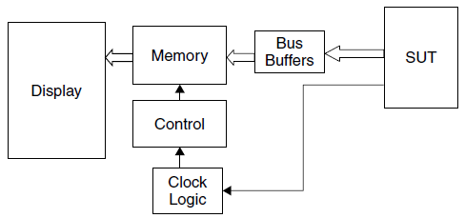
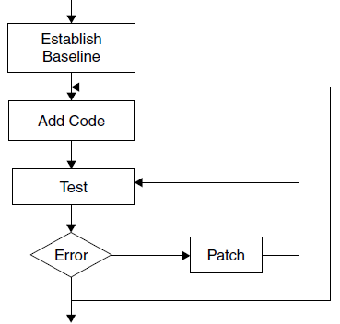
4 System Integration Tools

Slide 21
4 System Integration Tools
4.3 Logic Analyzer
These integrated environments typically are found on more expensive models, but they make the identification of performance bottlenecks particularly easy.
No matter how elaborate, all logic analyzers have the same basic functionality.
The logic analyzer is connected to the system under test by connecting probes that sit directly on the memory and data buses.
A clock probe connects to the memory-access synchronization clock. Upon each memory access, the data and address are captured by the logic analyzer and stored in buffers for transfer to the logic analyzer’s main memory, from which it can be processed for display.
Using the logic analyzer, the software engineer can capture specific memory locations and data for the purposes of timing or for verifying execution of a specific segment of code.

Slide 22
4.3 Logic Analyzer : Timing Instructions
The logic analyzer can be used to time an individual macroinstruction, segments of code, or an entire process.
To time an individual instruction, the engineer finds a memory location in the code segment of memory containing the desired instruction.
Then the logic analyzer is set to trigger on this opcode at the desired location, and on the opcode and location of the next instruction.
The trace is set for absolute time.
The logic analyzer will then display the difference in time between the fetch of the first instruction (the target) and the
next instruction.
This is the most accurate means for determining the instruction execution time.
For example, suppose the pasta sauce bottling plant system contains a 30-millisecond frame buffering task.
It is known from the linker output that instructions and data are found at memory location 4356 through 464B (hexadecimal).

Slide 23
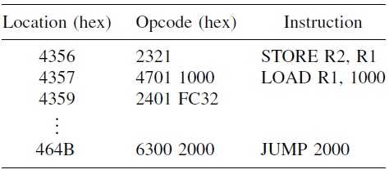
4.3 Logic Analyzer : Timing Instructions
Then the memory location, corresponding numerical opcode (in hex), and symbolic equivalent will appear in the display of the logic analyzer as follows:
The code represents part of an interrupt handler in which the first instruction is to disable all interrupts and the last instruction is to enable all interrupts.
If the logic analyzer is set to trigger on address = 4357, data = 4701, and capture-only
address = 4357 and data = 4701, the time to complete the LOAD (4701) will be
displayed. In this case, the “data” is the instruction opcode.

Slide 24
4.3 Logic Analyzer : Timing Code
The logic analyzer also provides an accurate method for measuring time-to-complete for any periodic task.
To measure the total elapsed time for any task in the system, set the logic analyzer to trigger on the starting and ending address and opcode for the first instruction of that task.
It should be the first instruction of the interrupt handler, usually a disable interrupt instruction.
Disable the interrupts for all higher-priority cycles and set the trace for absolute time.
The time displayed is the total time of that task cycle.
Consider the code shown in the previous example. If the logic analyzer is
set to trigger on address = 4356, data = 2321, and capture-only address = 464B and data = 6300, the absolute time to execute all instructions in the module will be measured.
Suppose the elapsed time is measured as 3 milliseconds for a 10- millisecond rate.
Then the utilization contribution from this code is 33.33%. This approach can be used to time one or several modules within a cycle, or even sections of code within a module.

Slide 25
4.3 Logic Analyzer : In-Circuit Emulator
During module-level debugging and system integration of embedded systems, the ability to single-step the computer, set
the program counter, and insert into and read from memory is extremely important.
This capability in conjunction with the symbolic debugger is the key to the proper integration of real-time systems.
In an embedded environment, however, this capability is provided by an in-circuit emulator. In-circuit emulation (ICE)
uses special hardware in conjunction with software to emulate the target CPU while providing the aforementioned features.
Typically, the in-circuit emulator plugs into the chip carrier or card slot normally occupied by the CPU. External wires connect to an emulation system.
Access to the emulator is provided directly or via a secondary computer.

Slide 26
4.3 Logic Analyzer : In-Circuit Emulator
In-circuit emulators are useful in software patching and for single-stepping through critical portions of code. In-circuit emulators are not typically useful in timing tests, however, because subtle timing changes can be introduced by
the emulator.
In certain ICE systems, the symbol table may be too large to load.
Privatization of certain global variables can be used to reduce the size of the symbol table.
For example, in C, judicious use of the static data type during testing can reduce the number of variables in the global symbol table. This aids the debugging process.

Slide 27
4.3 Logic Analyzer : Software Simulators
When integrating and debugging embedded systems, software simulators are often needed to stand in for hardware or inputs that do not exist or that are not readily available, for example, to generate simulated accelerometer or gyro readings where real ones are unavailable at the time.
The author of the simulator code has a task that is by no means easy.
The software must be written to mimic exactly the hardware specification, especially in timing characteristics.
The simulator must be rigorously tested.
Many systems have been successfully validated and integrated with software simulators and fail when connected to the actual hardware.

Slide 28
4.3 Logic Analyzer : Hardware Prototypes
In the absence of the actual hardware system under control, simulation hardware may be used instead of software simulators.
These devices might be required when the software is ready before the prototype hardware, or when it would be impossible to test the software on the actual hardware, such as in the control of a large nuclear plant.
Hardware simulators simulate real-life system inputs and can be useful for integration and testing, but are not always reliable testing the underlying algorithms, for which real data from live devices are needed.

Slide 29
4.3 Logic Analyzer: Software Integration
A deliberate approach must be used when performing system integration to ensure system integrity.
Failure to do so can lead to cost escalation and frustration.
Software integration approaches are largely based on experience.

Slide 30
4.3 Logic Analyzer: Software Integration
A deliberate approach must be used when performing system integration to ensure system integrity.
Failure to do so can lead to cost escalation and frustration.
Software integration approaches are largely based on experience.

Slide 31
4.5 A Simple Integration Strategy
In any embedded operating system it is important to ensure that all tasks in the system are being scheduled and dispatched properly.
The first goal in integrating the embedded system is to ensure that each task is running at its prescribed rate, and that context is saved and restored.
This is done without performing any functions within those tasks; functions are added later.

Slide 32
4.5 A Simple Integration Strategy
A logic analyzer is quite useful in verifying cycle rates by setting the triggers on the starting location of each of the tasks involved.
During debugging it is most helpful to establish the fact that cyclic processes are being called at the appropriate rates. Until the system cycles properly, the application code associated with each of the tasks should not be added.
The success of this method depends on the fact that one change at a time is made to the system so that when the system becomes corrupted, the problem can be isolated.

Slide 33
4.5 A Simple Integration Strategy
The approach involves establishing a baseline of running kernel components (no applications programs).
This ensures that interrupts are being handled properly and that all cycles are running at their prescribed rates, without worry about interference from application code.
Once the baseline is established, small sections of applications code are added and the cycle rates verified.
If an error is detected, it is patched if possible.
If the patch succeeds in restoring the cycle rates properly, then more code is added.
This ensures that the system is grown incrementally, with an appropriate baseline at each stage of the integration.
This approach represents a phased integration with regression testing after each step.

Slide 34
4.6 Patching
The process of correcting errors in the code directly on the target machine is called patching.
Patching allows minor errors detected during the integration process to be corrected directly on the target machine, without undergoing the tedious process of correcting the source code and creating a new load module.
It is also useful in repairing software remotely, for example, in space-borne applications.
Patching requires an expert command of the opcodes for the target machine unless a macro assembly-level patching facility is available.
It also requires an accurate memory map, which includes the contents of each address in memory, and a method for inserting directly into memory.
This capability is provided by many commercial development environments and by in-circuit emulators.

Slide 35
4.6 Patching
Patching, which is analogous to placing jumper wires on prototype hardware, typically requires only a minor change of memory contents.
If the patch needed fits into the memory space accorded to the code to be changed, then it is considered an in-line patch.
for example, a 1 was supposed to be added to register 1 (R1) instead of a 0. This error can be changed easily by altering the memory location containing the LOAD R1,0 instruction to LOAD R1,1.
If the patch requires more memory than is currently occupied by the code to be replaced, it is considered an oversized patch. In this case a JUMP to some unused portion of memory is required, followed by the patched code, followed by a return JUMP to the next significant location.

Slide 36
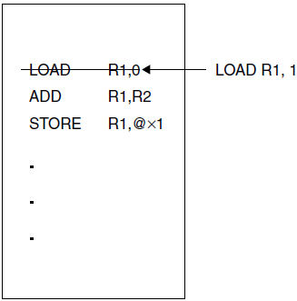
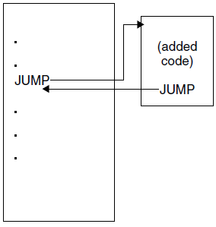
4.6 Patching

Slide 37
4.6 Patching
The loading of patches during system integration can often be automated.
However, a large number of patches and patches on top of others can become confusing. It is imperative that a careful record be kept of all patches made, that the patches eventually find their way back to the source code, and that a new system be generated before validation testing begins. This is essential from a maintenance standpoint. Final testing should never be performed on a patched system.
Patching of software written in object-oriented languages is very difficult because of the lack of a straightforward mapping from the source code to the object code.
Symbolic debuggers are quite helpful in this case, but even so, in this situation patching is risky at best.

Slide 38
4.7 The Probe Effect
The uncertainty principle, originally postulated by Werner Heisenberg in 1927, states essentially that the precise position and momentum of a particle cannot be known simultaneously.
An analogy to the Heisenberg uncertainty principle applies in software integration.
While software systems do not explicitly deal with electrons (except as ensemble behavior), uncertainty arises because the more closely a system is examined, the more likely the examination process will affect the system.
This fact is especially true for embedded systems where test probes can affect timing.

Slide 39
4.7 The Probe Effect: Example
An engineer is debugging the pasta sauce bottling system and discovers that a certain deadline is not being met.
Some debugging code is added to print out a preliminary result to a file. But after adding the debugging code, the problem goes away.
Declaring success, the engineer removes the debugging code and the problem reappears. In this case, it is clear that debugging code somehow changed the timing of the system.
The software version of the Heisenberg uncertainty principle should be taken as a warning that testing methods often affect the systems that they test.
When this is the case, nonintrusive testing should be considered, for example, using a logic analyzer. Furthermore, wherever there is an inverse correlation between two variables affecting system, Heisenberg uncertainty is suggested.

